Slide 1

MOBILE
WORK FORCE
MANAGEMENT SYSTEM

Slide 2

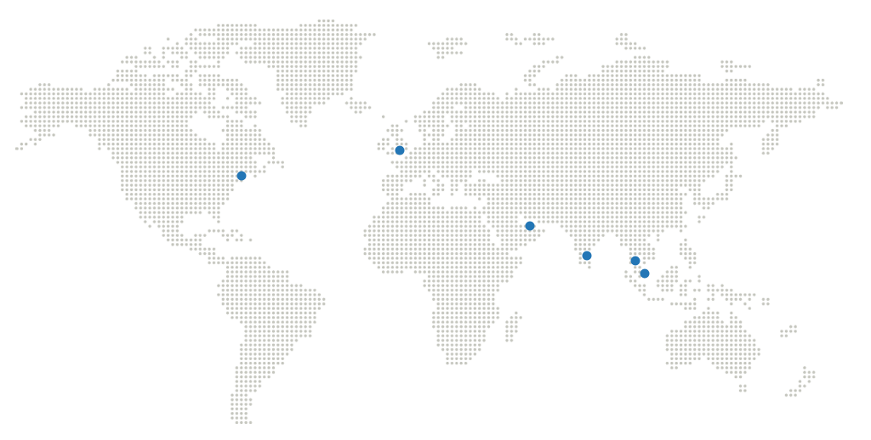
OUR GLOBAL REACH
United Kingdom
European Headquarters
Gatwick, UK
UAE
Middle East Headquarters
Dubai Internet City, Dubai
Singapore
Asia Pacific Headquarters
Siemens Centre, Singapore
Americas
US Headquarters
Edison, NJ 08820
Malaysia
Kuala Lumpur, Malaysia
India
India Headquarters
Chennai, India

Slide 3
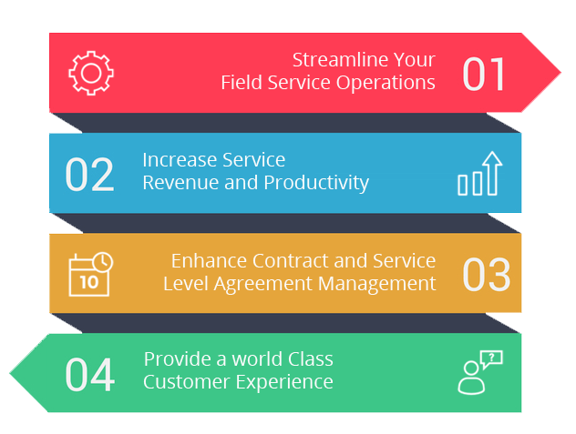
SOLUTIONS - FIELDPOWER
Why FIELDPOWER ?
“Award Winning Mobile Field Service Management Software & solution”
FieldPower’s Mission
Get the Right Resource
@ Right Time
@ Right Place
@ Right Skills
@ Right Parts
@ Lowest cost
With the highest quality of Service to your client

Slide 4
SOLUTIONS - FIELDPOWER
CONNECT CUSTOMERS, AGENTS, DISPATCHERS AND SERVICE TECHNICIANS ON A SINGLE PLATFORM
Customer
Book a service appointment anywhere, anytime
Have the technician arrive on time with the right skills
Service Agents
Get a complete view of the customer
Create and schedule a Work Order from any case
Dispatcher
Optimize job scheduling based on your business rules
Real-time insight into service operations
Field Technician
Run service tasks on-site from any device
Access key information to complete the job quickly
Streamline Operations Across the Entire Service Chain

Slide 5
KEY BUSINESS BENEFITS
Improve Service Quality, Productivity and Utilization
Automated, dynamic scheduling, and routing of technicians along with improved knowledge management (e.g. access to diagrams, manuals and troubleshooting tips) pairs the most qualified people and appropriate tools with each job
Optimized travel plans that reduces travel time and costs, thereby achieving high productivity with less travel.
Higher First Visit fix rates
Shorter appointment windows
Improved SLA compliance
Cut Costs
Software assisted staffing takes into account technician salaries, overtime, and many other variables to optimize human resource costs
Improved Inventory management and forecasting minimizes repeat visits by ensuring parts availability
Less technician overtime
Improved parts management
Lowered travel (fuel) costs
Improved Mobile FieldPower
User friendly hybrid mobile application, allows technicians to maintain up-to-date work order logs to improve visibility and control
In-built GPS tracking tracks and records technician movements.
Capture customer signature, collect payments and fill-up dynamic checklists.
Maintain work calendars
Update job status and attachments
define and maintain dynamic checklists
Improved Dashboards and Forecasting Reports
Role-based KPIs and reporting functionality make monitoring and reporting more effective forecasting reports for allocating future resources
Configurable individual dashboards for management, dispatchers and technicians
Dynamic Reporting for user defined reports
Ability to print and export data to many formats

Slide 6
BENEFITS OF WORK FORCE MANAGEMENT SYSTEM
Executives
Operations
Mobile Resources
IT Organization
End Customer
Rapid and On-demand Configuration
Robust reporting and Business Intelligence
Revenue Expansion and Growth
Delivering productivity Gains
State-of-the-art Routing and Scheduling
Advanced Work Process Automation and Reduced Back Office
Improved Resource and Asset Utilization
Increased Productivity
Enhanced Coordination with Dispatch
Electronic Capture of All Information, Including Signatures
Flexible Deployment Options with Off-the-shelf Functionality
Highly Scalable Software Platform
Comprehensive Integration with Existing Apps
Improved Customer Experience
Faster Response and Ticket Closing
Better Visibility and Status Information
Differentiator Driving Customer Loyalty

Slide 7



INDUSTRIES WE SERVE
Telecom &
Capital Equipment
Computer &
Office Equipment
REO &
Constructions
Residential &
Commercial Services
Retail & logistics
Manufacturing
Oil & Gas
Consumer Electronics
HVAC
Medical Equipment
Utilities
Insurance

Slide 8




























CUSTOMERS

Slide 9


























INTEGRATION EXPERTISE
Metasolv M6
Eagle Map
IVR
AccessCare
FMS
SCM
MMS
Spear
MCSS

Slide 10
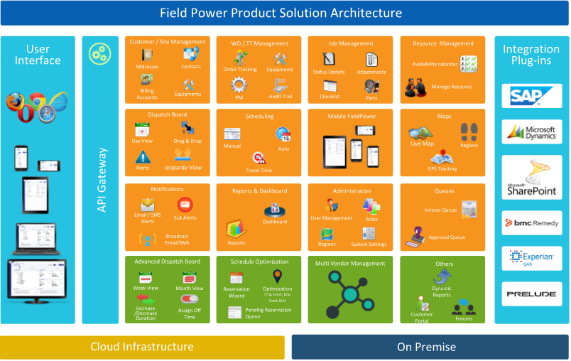
FUNCTIONAL ARCHITECTURE

Slide 11

CORE FIELD SERVICE CAPABILITIES
Scheduling & Dispatch
Get the Right Resource @ Right Time @ Right Place @ Right Skills @ Right Parts @ Lowest cost
Optimization & Routing
Optimize your work force for increased productivity
Equipment / Asset Management
Track all the customer equipment and assets
Work order management
Track all the details of the customer, job, parts, etc
Mobile APP
Iphone, IPAD, Android
Offline/Disconnected access
GPS tracking
Photo capture
Signature capture
Attachments/checklist
Resource Management
Manage all the field service resources and availability including requirements and tools
Inventory managements
Manage both truck and warehouse inventory
Contracts and SLA’s
Manage all the customer contracts/ warranty and entitlements
Billing
Track and invoice customers
GPS Tracking
Track technician using live Maps

Slide 12







Key Functionalities
Customer/Site Mgmt.
Quote Management
Work Order Mgmt.
Preventive Maintenance
Multiple site addresses & contacts
Business, Consumer / Residential Site
Site On Premise Equipment / Node details
PM Schedules
Track Recent Order History
Tech Preference & Blocking
Auto Coordinator Assignment
Customer/Site Profile Photo
Customer/Site Business Hours
Create Quote
Manage Quote
Quote Revision
Print / Email Quote
Quote Win to Order Convert
Quote Loss
Quote Reopen
Link to Work ticket
Create through easy wizard
Field Workorder Management
In-house workorder Management
Multiple jobs with different technicians and timing
Automatic scheduling
Manual scheduling
Parts Request
Capture Equipment details
View Audit SMS & Email Log
Plan the task details for PM
Flexible & configurable schedule patterns
Auto generation of Work Orders based on Schedule
Auto Work Orders creation based on specific conditions
View planned maintenance activities for a period
Alert people when job is due
Scheduling & Dispatch
Technician Management
Job Management
Dynamic Forms
Automatic or Manual Scheduling
Bulk scheduling
Drag & drop – Day/Week/Month
Auto calculate travel time
Multiple Scheduling Parameters
View Jeopardy Jobs
Instant notifications to technician
Reservation
Optimization
Multi Point Destination & Routing
Availability Calendar
Working time and off times in calendar view
Technician Skills
Technician Certifications
Technicians’ working Regions
Manage vendor technicians
Manage Tech Pricing/ Cost
Track Real time Job Status
Equipment and Spare Parts
Additional work requests
Attachments with Gallery View
Payment information
Customer signature
Dynamic Forms
View Audit Log, SMS & Email Log
Job Print & Email (PDF)
Job Report with Photo Attachment
Create customized Form template
Conditional Checklist Templates
Add customized Questions
Provide Headers & Define various type of response controls
Export & Print Checklist
Attach Checklists in WO Master or ad hoc
Photo / Document Uploading
Forms Version control

Slide 13






Key Functionalities – Contd.
Contract / SLA Management
Dashboards & Reports
Billing & Invoice
Spare Parts Management
Multiple SLA Configurations
Job based SLA
Equipment based SLA
Track SLA adherence against jobs
SLA based reports
SLA alerts in Dispatch Board
Generate variety of Reports
Export or Print Reports
Detailed Dashboards
Ccomprehensive role based view
Drill down options
Descriptive Dashboard
Work Request based pricing
Flat or Percentage Discounts
Additional Ad Hoc charges
Approval Queue
Automated or Manual Invoice
Flexible payment options
Integration support
Part master – Add & Import
Multiple Warehouse
Manage Vehicle Inventory
Stock Transfer between Warehouses
Inventory Adjustment
Track inventory by location & bin
Part Request and Part Receiving
Inventory reports
Vendor Management
Project Management
Administration
Customer Portal
Maintain multiple vendors
Complete encapsulation of data between vendors
Manage Vendor Pricing/ Cost
Schedule to vendor technicians
Maintain and monitor vendor technicians and their activities
Vendor BOQ Parts and Cost
Manage Project Details
Define Project duration, PM and Business owner
Map Vendors to Project
Configure Project related settings
Manage Project related documents
View Sites/Assets associated with the Project
Load Project schedules and assign partners and Technician
Manage Region & Zones
Manage Skills & Certifications
Manage Roles & Role Privileges
Manage Technicians
Manage Vendors
Manage Dynamic Forms
Manage Work Order Master
Manage Custom Fields
Define Holidays
System Settings
Manage Custom Views
Separate Portal for Customer
Multiple User Client Access
Track current Order status
View Recent Order History
Manage their Own Properties & Work Order details
Impressive analytical dashboard
Manage profile

Slide 14





Key Functionalities – Contd.
Mobility
Photo Management
Location Management
Integration
IOS, Android
Job Calendar, Week & Day View
Jobs Location in Map View
Displaying Flags for Job
Job details view
Update the current Job Status
Check In / Check Out
Attachments
Signature capture
Add & Modify Equipment
Parts Request
Dynamic Forms/Checklist
Add additional tasks and charges
Payment Collection
Customer’s recent order history
GPS Tracking
Add & Edit Instructions and Notes for a job
Technician Profile update
Online and Offline mode
Auto-Syncing of Jobs & Activities
Photo Cropping / Editing
Annotation
Audio Recording
Face ID , Finger Print scanning
Capture Real time Sign in info using uploaded Photo
Timestamp, Geo location etc.,
Robust Drag and Drop images/documents
Photo Annotations
Photo Cropping
Drawing over image
Audio recording
Image attachment with Lat & Long
Image Compression and Server Side validation
Audio & video upload and attachments
Before, During and after Photo
Duplicate Photo detection
Customized Naming
Photo Image Sizing (restriction /unlimited)
Identify exact job location
Identify technician’s location
Compatible with GIS Standards
GPS or Status based maps
Job Details in map
Track Technician Travel History
QuickBooks
SAP
Dynamics AX
Service Now
Remedy Ticketing
Bing/Google Map
Weather Alert
Others
Email & SMS
Value Addition
Configure templates for email /SMS notification
Define recipients of the email/SMS
Job notification to Vendor & Technician
Job status notification to the defined email recipients
Broadcast email & SMS to group of recipients
Online communication log
Two way SMS Communication
White Label
24 x 7 Support
Dedicated Private Cloud
Dedicated – Hot line Support
Customer Portal
Internationalization
Custom Reports
Chat-bot
Video Chat
Text Chat
RPA

Slide 15


Connected FieldPower – Core Capabilities
FieldPower
Mobile App
Sensors
Contractor, Vendor,
Manager Portal
Gateways
IoT
Platform
FP - IoT
Connected
FieldPower
Customer
Portal
Connectivity
Scheduling &
Optimization
Engine

Slide 16


FieldPower IoT Functional Architecture
Sensors
IoT Platform
FieldPower IoT
FieldPower
Fuel
Battery
Fire / smoke Detector
High/low AC/DC voltage
Camera
Temperature
FieldPower can be integrated with Leading IoT platforms (Azure, AWS, IBM Watson etc.,) and 3rd party IoT clouds
System waits for Alarm to mature
Once matured, it’s pushed to FP via API to create Ticket
FieldPower Schedules to the Technician and tracks till completion
Technician uses mobile FieldPower to complete tickets

Slide 17















FIELD SERVICE PROCESS FLOW – TT & WO
CUSTOMER or
CALL CENTER
SCHEDULING
TECHNICIAN
DISPATCH
SPARES UPDATE &
CLOSURE
Accept New Job
Emergency
New Request
Create Service Tickets/
Work Order
Jeopardy Situation
Schedule the
Technician
Complete Job #1
Status Update
Update spares Used
En Route to Customer
Status Update
Approve & Close the PM Ticket
Accept the Job
Status Update

Slide 18
FIELD SERVICE PROCESS FLOW – PREVENTIVE MAINTENANCE
PM
SCHEDULE
SCHEDULING
TECHNICIAN
DISPATCH
SPARES UPDATE &
CLOSURE
Accept New Job
Emergency
New Request
Create PM ticker based on PM schedule
Schedule the
Technician
Jeopardy Situation
Complete Job #1
Status Update
Update Spares Used
En Route to Customer
Status Update
Approve & Close the PM Ticket
Accept the Job
Status Update

Slide 19
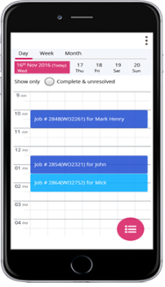



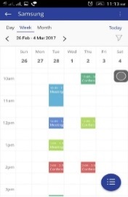
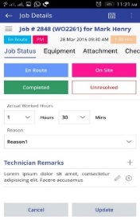
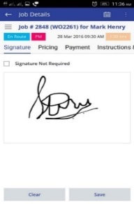
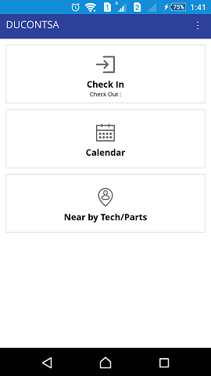
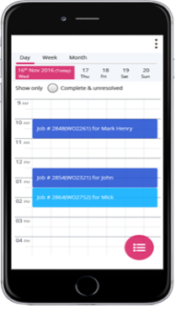
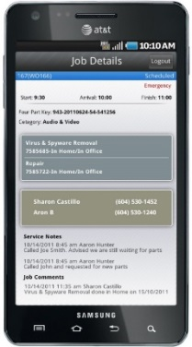


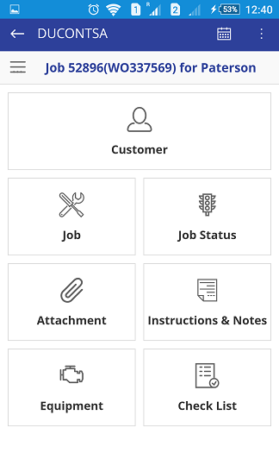
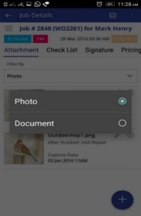
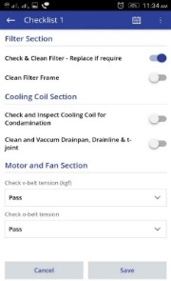
A DAY IN THE LIFE OF A FIELD TECH WITH FIELDPOWER
Calendar See calendar with all the appointments for the day / Week / Month
Time & Attendance
Check-out and end your day
Status Updates
Update job
details & do status updates
Signature Capture
Capture Signature of customer / site contact
1
2
3
4
5
6
7
8
Time & Attendance
Check-in from any location to start your day
Customer / Job Details
View the details of the job thru icon driven menu
Attachments Attach images from site / download files
Dynamic Checklist
Fill up the dynamic checklist created by Admin

Slide 20




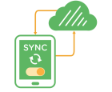







TECHNOLOGY FEATURES
Industry Agnostic
Cross Browser Compatibility
Seamless Integration
Hybrid Mobile Application
Custom Fields, Dynamic Themes
Mobile Offline Sync
Plug-N-Play Modular Architecture
Data Store Neutrality
Small, Medium and Large enterprise support
On-Premise and on-Cloud (SaaS) Solutions
Supports Internationalization
Responsive Layouts / Designs

Slide 21























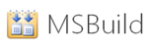












TECHNOLOGY STACK
Front End
Database
Framework
PowerShell
Tools
Mobile
Testing

Slide 22
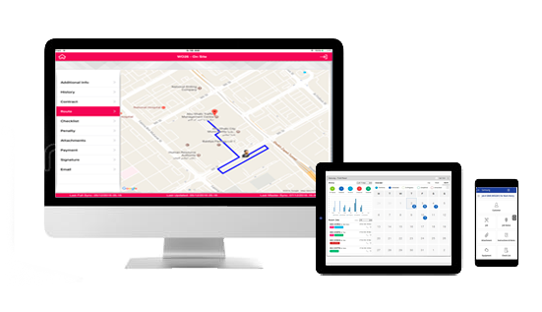
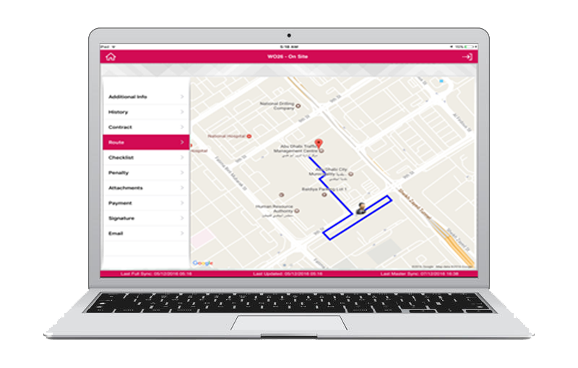
MULTI- CHANNEL (DESKTOPS, LAPTOPS, MOBILE, TABLET)

Slide 23
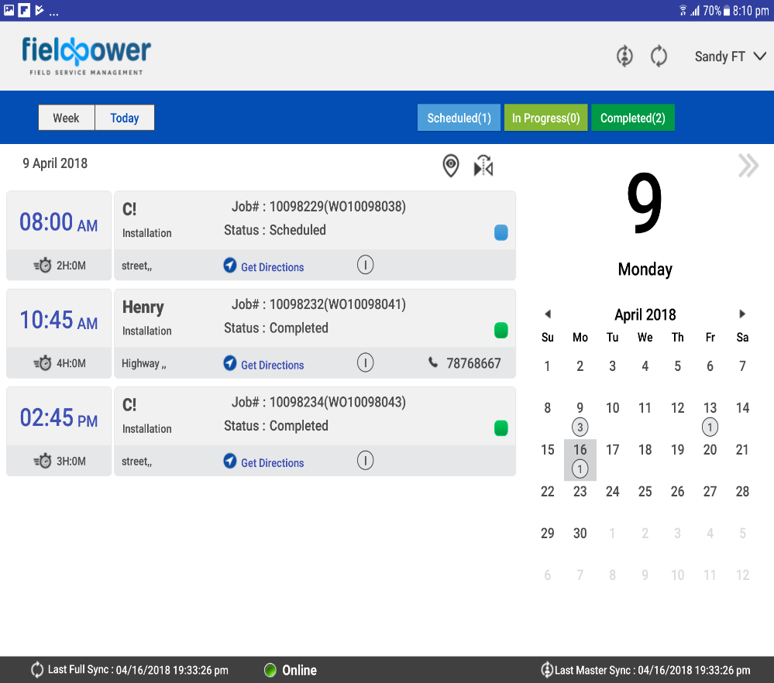
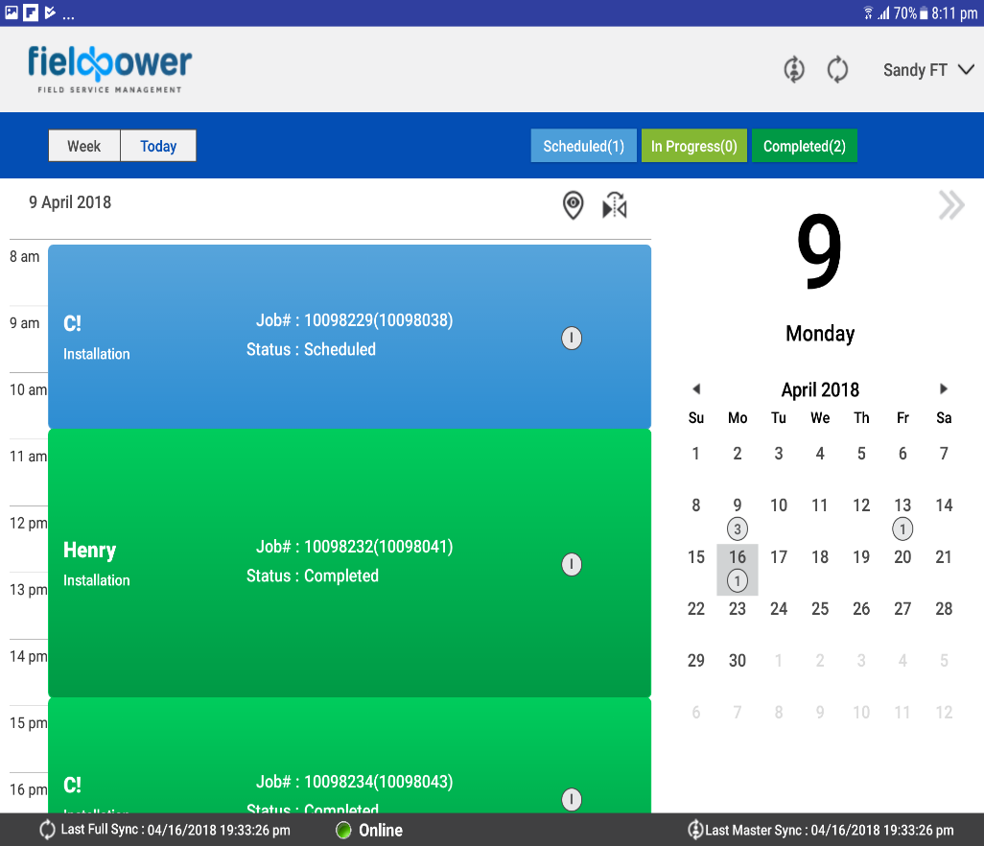
TABLET VIEW

Slide 24
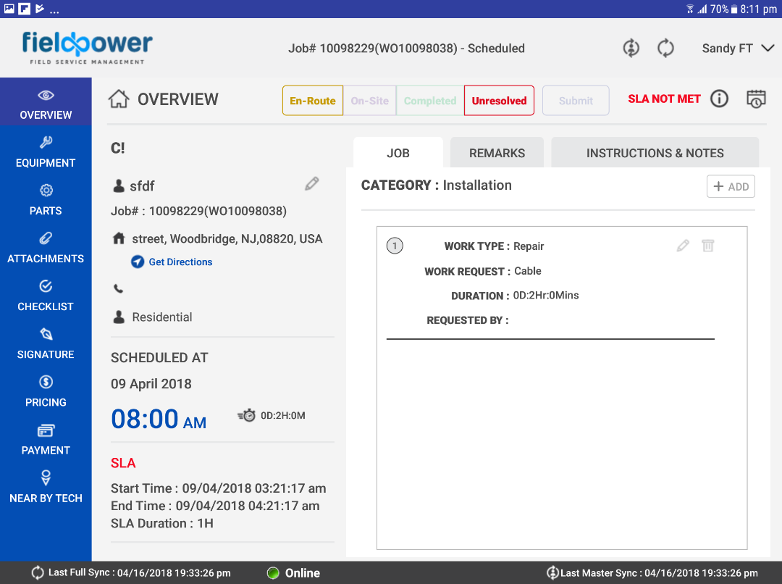
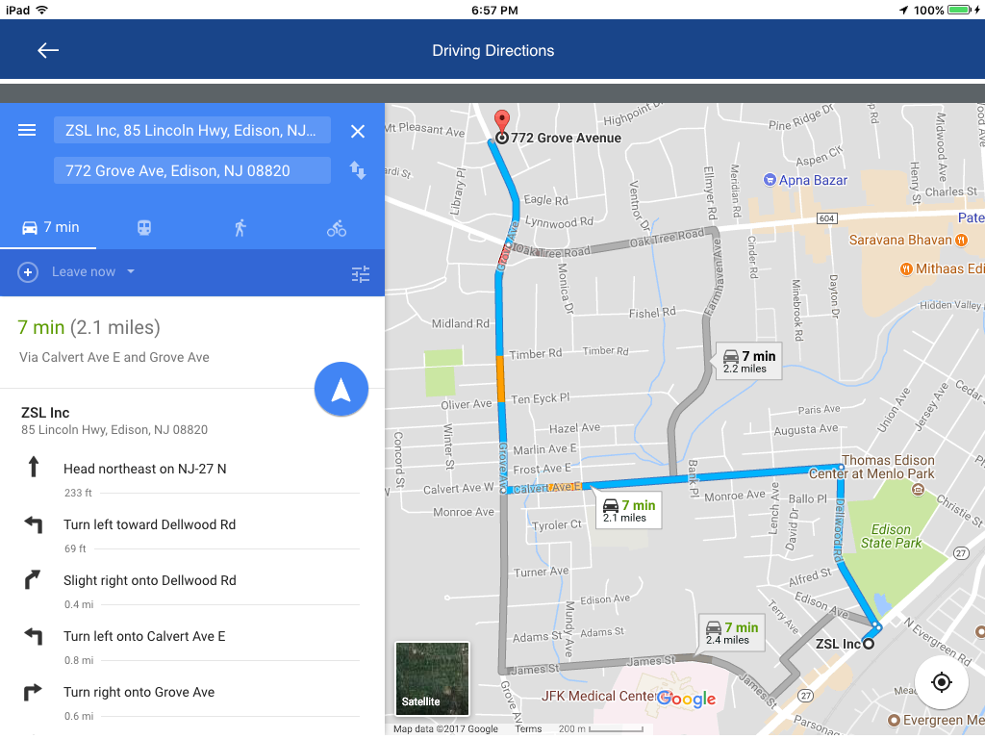
TABLET VIEW

Slide 25
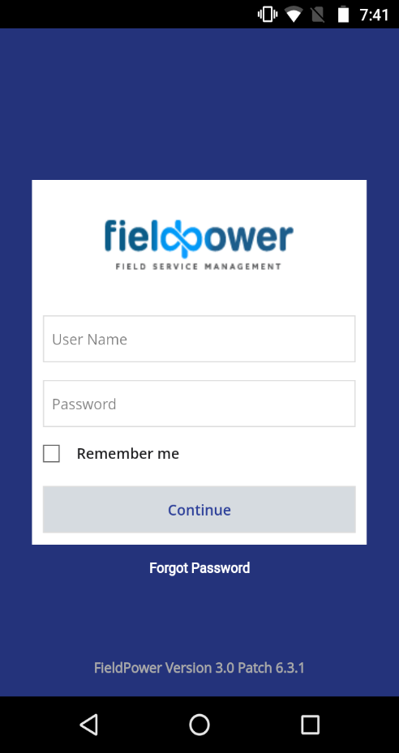
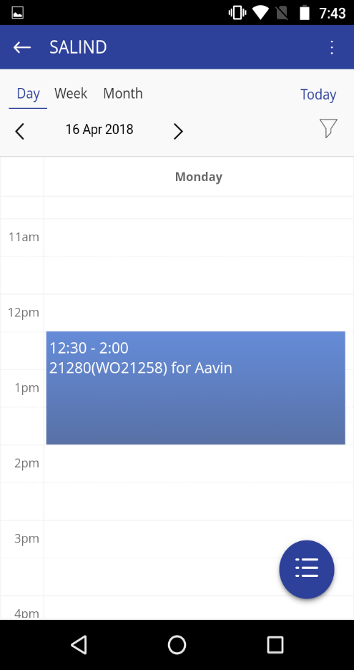
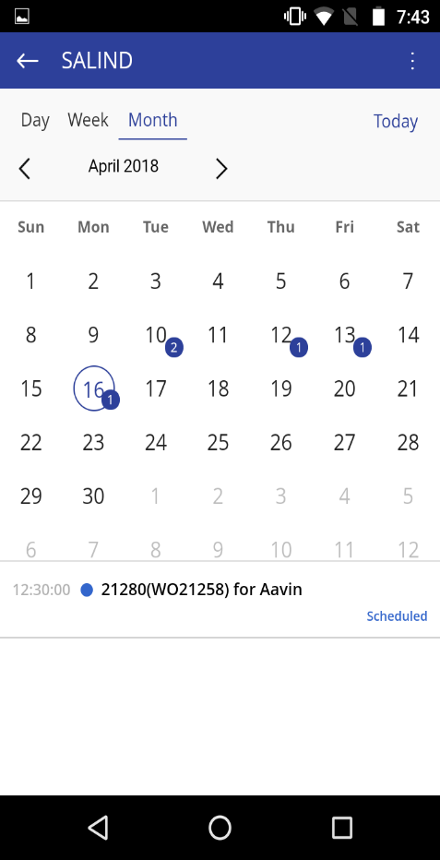
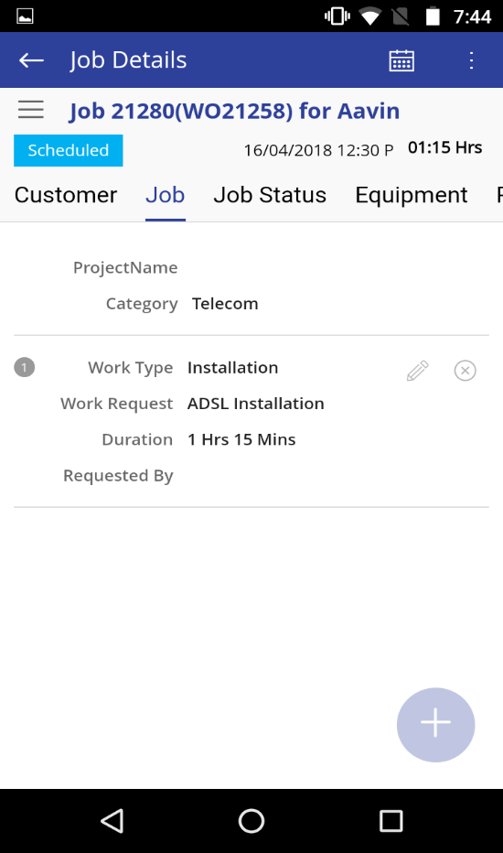
MOBILE VIEW

Slide 26
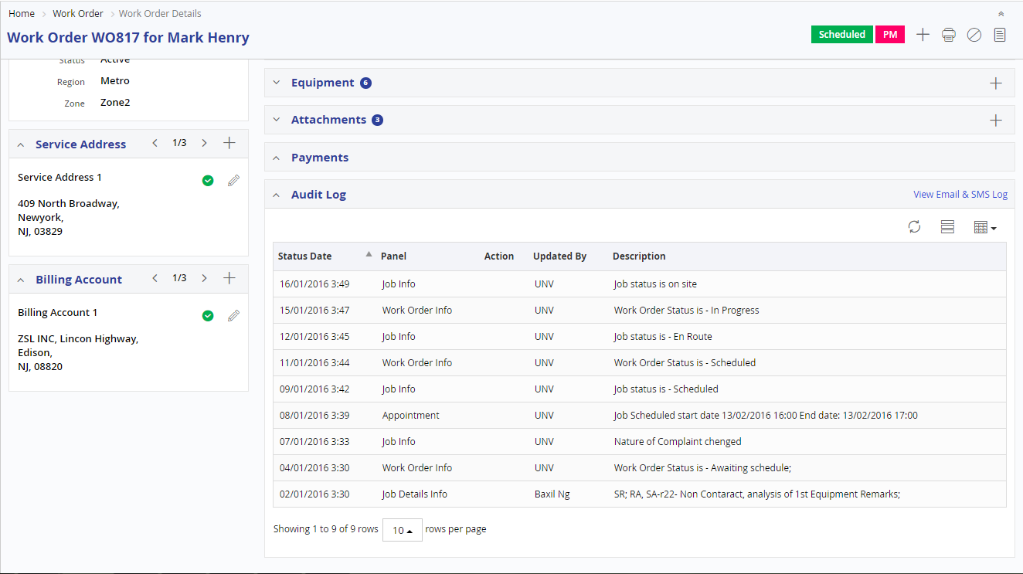
SERVICE ORDER - SINGLE SCREEN VIEW

Slide 27
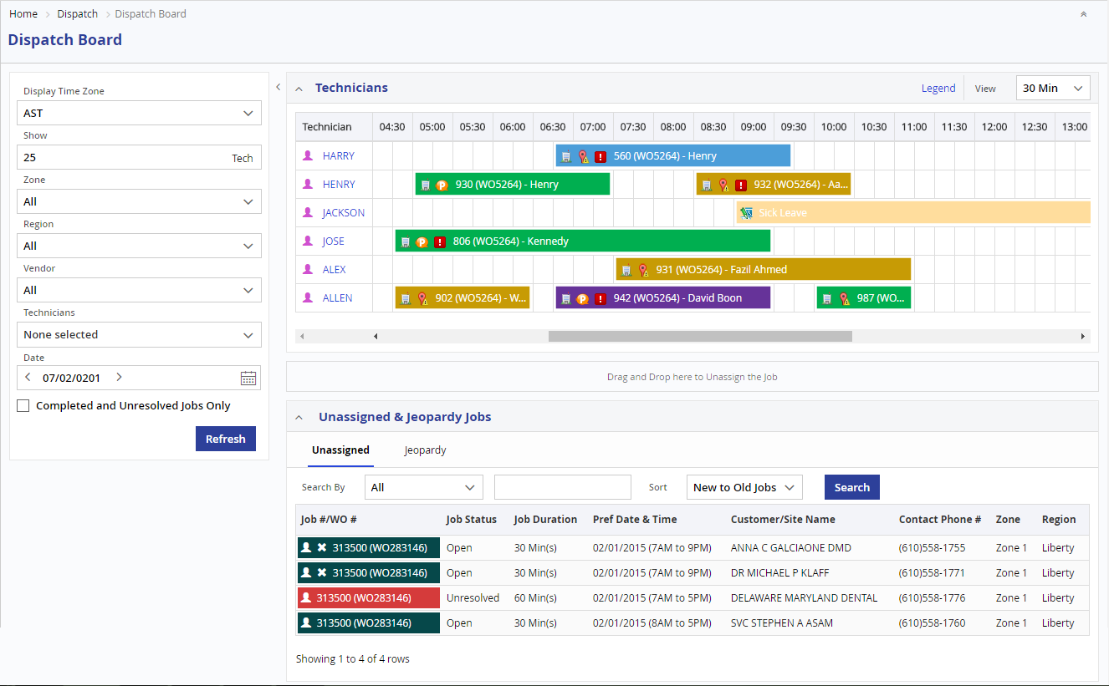
DISPATCHER/SCHEDULER BOARD

Slide 28
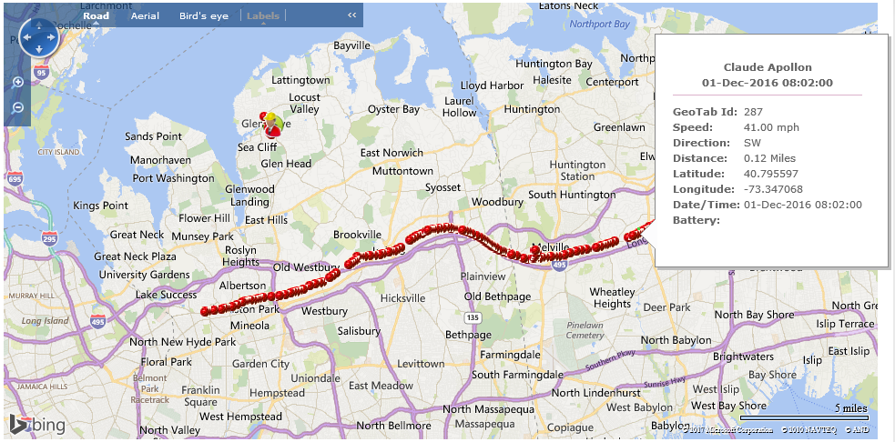
GPS LOCATION

Slide 29




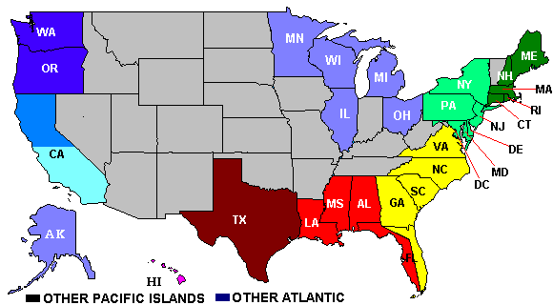














SCHEDULING PARAMETERS
Service
Location
FSE’s Current
Location
Spare Parts
Availability
Work
Schedule
Region
/ Zone
Route
SLA
Spare Parts
Location
Skill
Competencies
Certification
Cost Per Job
Drive Time
Pass Holder
Customer
Preferred Time
Over Time
Crew jobs
Priority
Job Duration

Slide 30
% OF IMPROVEMENTS
Customer Satisfaction
Workforce Productivity
First Time Fix Rates
First Call Schedule,
Cut down Missed Appointments
and Improved SLA
Continuously monitor the
Technician utilization using
Real Time availability and
Optimize the usage
Schedule the Right Technician with Right Skill, Right Parts on Right Time
21%
17%
22%
19%
20%
16%
13%
Call Centre Support Costs
Inventory Carrying Cost
Total Service Costs
Overtime Costs
Reduce the Customer Calls using Proactive Alerts and Self Scheduling Portal
Inventory Management reduces Overstocking Costs and Missing Parts & Warranty leakage
Optimize the service route and decrease the travel time and travel miles
Utilize the Resource
in Optimized way using
Real Time Scheduling
to reduce the Overtime Cost

Slide 31
SECURITY & AUDIT
SECURITY
AUDITS
Highly secure identity & access management using oAuth protocol
Secured login for each user with 128 bit encryption
Top ten security vulnerabilities as specified in the OWASP
(Open Web Application Security Project) including cross-site scripting and SQL injection are addressed
Sensitive data such as passwords are stored in encrypted format
User management and access privileges to the application are tightly controlled and configured with the role-based, access control module.
User login to logout audit trail
Application error logs
Audit trail for master & Transaction Records
who and when the records are created or updated

Slide 32
OUR VALUE PROPOSITION
Deep domain and technical expertise in telecom / telecom tower infrastructure specifically working with companies like Saudi Telecom, OmanTel, TSTT etc
Intelligent Automated task scheduling – Ducont’s Field Service Management creates initial estimates of task duration, and records the actual time taken. The estimate is based on automatic system suggestions, depending on the task type and employee skills, availability, and location etc. We recommend at least 20+ parameters.
Increase efficiency of field service business – we provide a self-care portal for customers and partners, monitor your field service business and troubleshoot any issues thanks to real-time notifications, browsing of data usage, reports and diagnostics
Improve customer experience - understanding the cause of a service failure, track patterns and trends, reporting and analysing anomalies, and notifying customers to improve their business and operational results
Roadmap for Field Power and The Internet of Things (IoT) – Focusing on : Power of Connectivity to Field Service, Predictive Maintenance Service Model for Better Business Outcomes, Connecting Devices with IoT to Generate Trigger Automated Action, Increase First Time Fix Rate with Accurate Data Collection
Mobile App on iOS & Android for Field Service Staff, Management and other related staff
Decrease workloads and increase productivity – decrease dispatcher workloads with an Automated Dispatching module, and order completion reporting performed directly by service technicians. Maximize your field workforce productivity thanks to improved time and resource management.
Remote System Access –field technicians in remote locations can log in to the system via Ducont’s proprietary mobile app given to technicians.
Execute tasks across regions– simplify task execution across territories / regions using built-in Geographical Information System (GIS), that processes information regarding employee location, presenting both employee and task location.
Advanced Reports – standard and advanced reports related to all field service activities are provided through advanced reporting module.

Slide 33

THANK YOU

